Slide 1

Expressions
Prof. Dr. Md. Saiful Azad

Slide 2
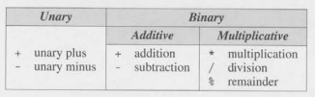
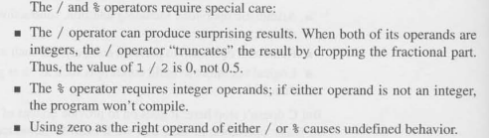
Arithmetic Operators

Slide 3


Operator Precedence

Slide 4

Assignment Operators
Simple Assignment
Chained Assignment
Compound Assignment

Slide 5
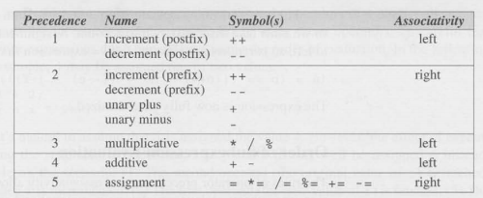
Increment and Decrement Operators
i = i + 1
i += 1
i++
++i
k = ++1 + j++

Slide 6

Expression Evaluation

Slide 7
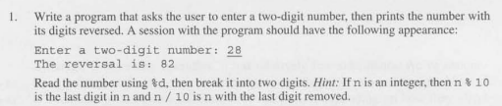

Problem Set

Slide 9

The End

